Slide 1


Site selection criteria www.aqua-park.asia
Use of GIS (Geographical Information System) for site selection

Slide 2
Site selection criteria – Factor to consider
Conflicting uses of area
Shore line contour
Depth profile
Exposure to wind
Fetch
Currents
Maximum wave height
Tides
Water temperature
Salinity

Slide 3
Site selection criteria – Factor to consider
Dissolved oxygen concentration
Pollution (organic and inorganic)
Phytoplankton and zooplankton occurrence and distribution
Potential danger of red tides, plankton blooms, biofouling
Predators - crabs, fish, birds, seals, etc.
Flora and fauna studies (indicator organisms)
Accessibility to the site – roads, transportation, airport, port, etc.

Slide 4
Site selection criteria – Factor to consider
Infrastructure - facilities, security, communication, electricity, freshwater
Potential for expansion - availability of adjacent area
Environmental assessment, monitoring and control – bioremediation and mitigation
Legal framework – policies, regulations, licenses, permits, concessions, etc.
Public and government acceptance of project

Slide 5
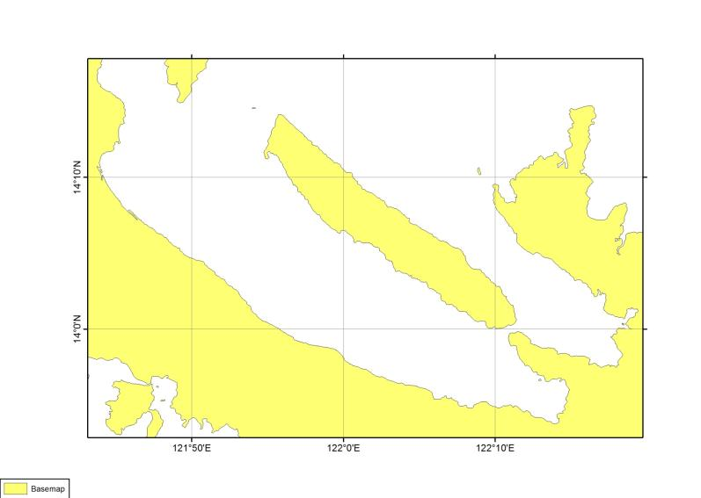
Basemap

Slide 6
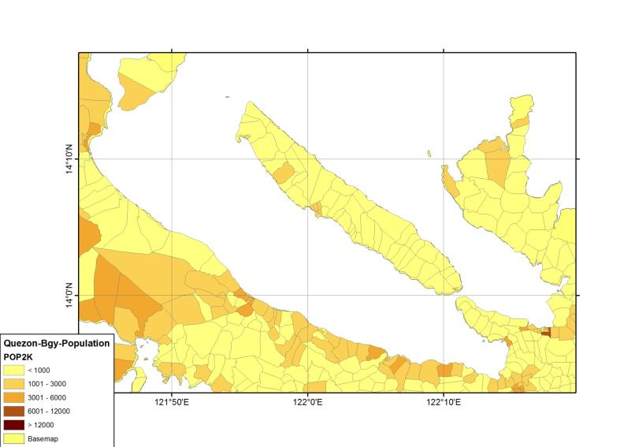
Basemap

Slide 7
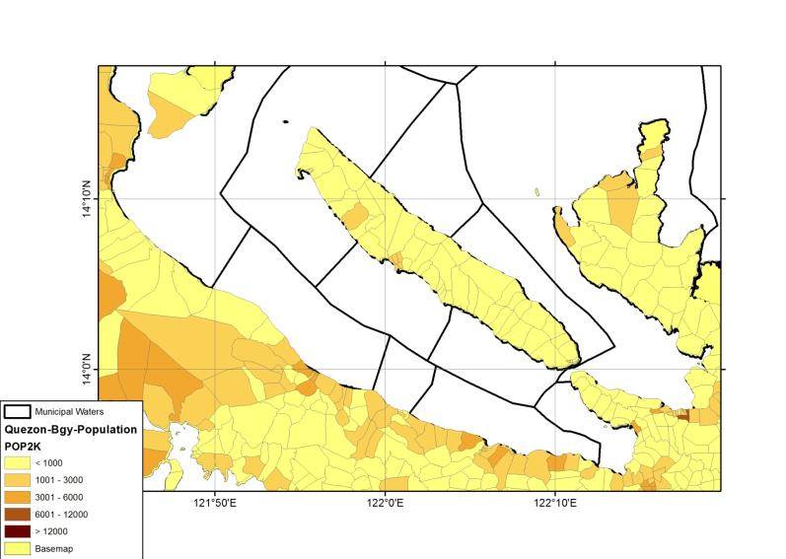
Basemap

Slide 8
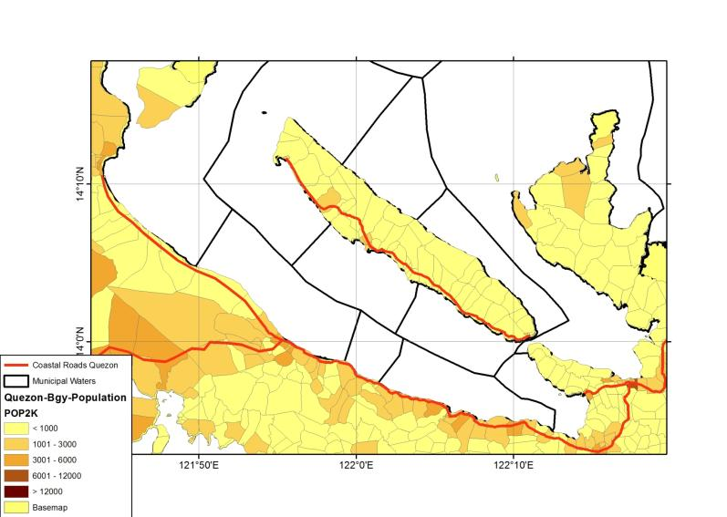
Basemap

Slide 9
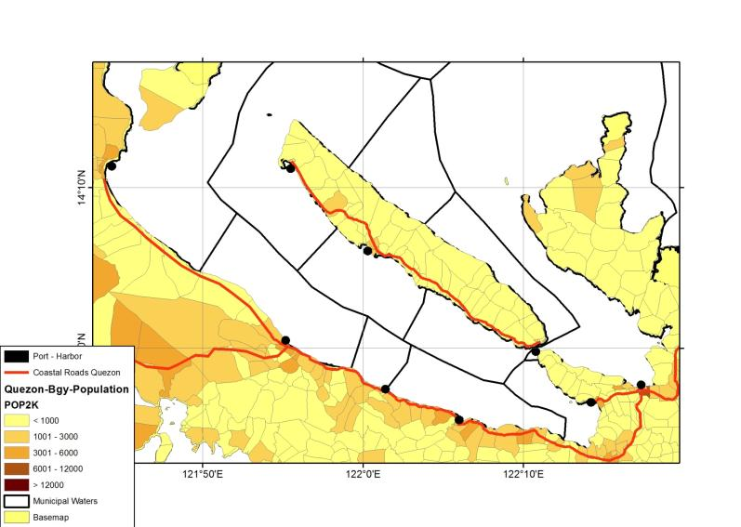
Basemap

Slide 10
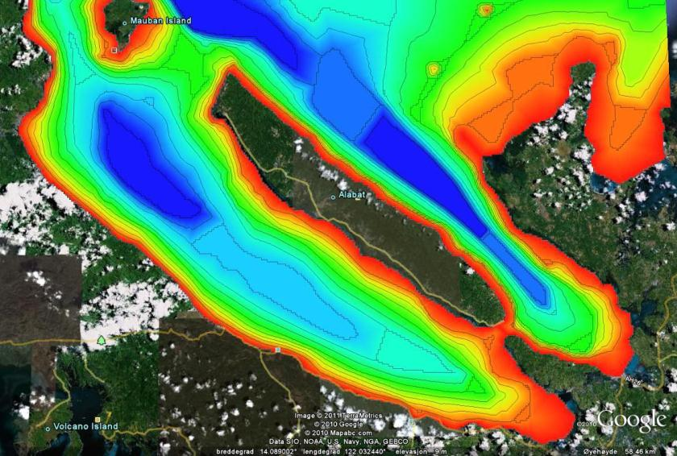
Basemap

Slide 11
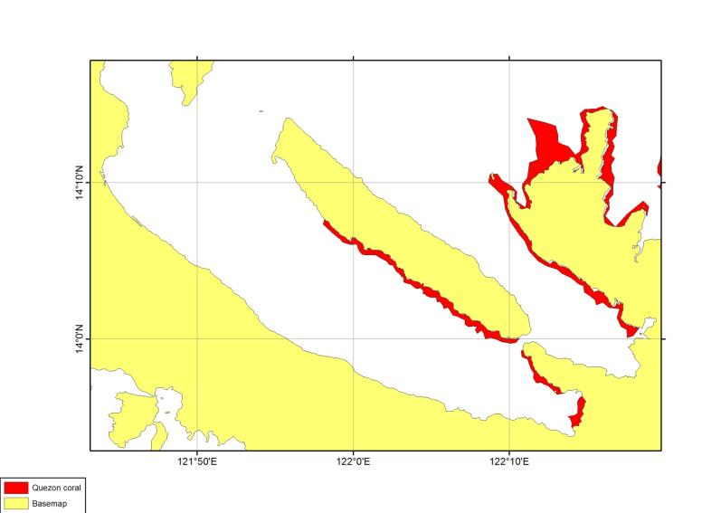
Sensitive areas

Slide 12
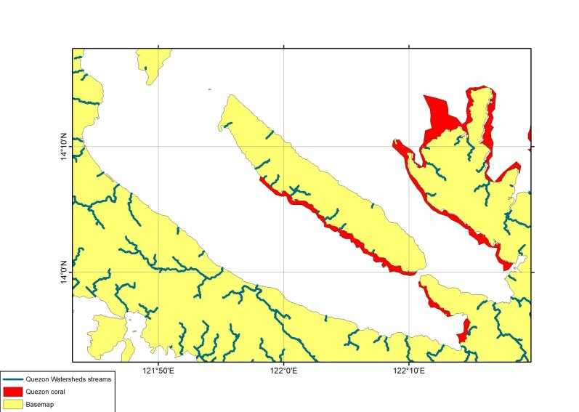
Sensitive areas

Slide 13
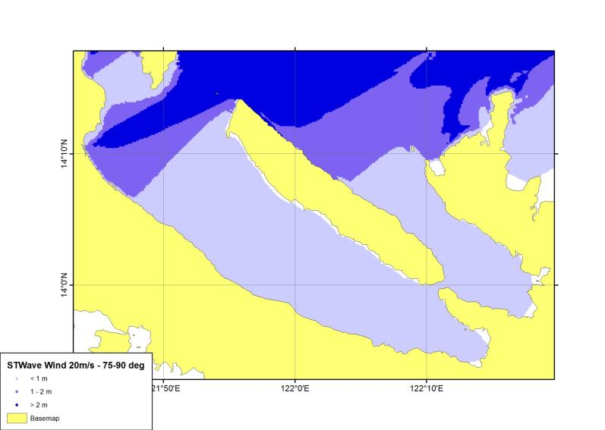
Wave model

Slide 14
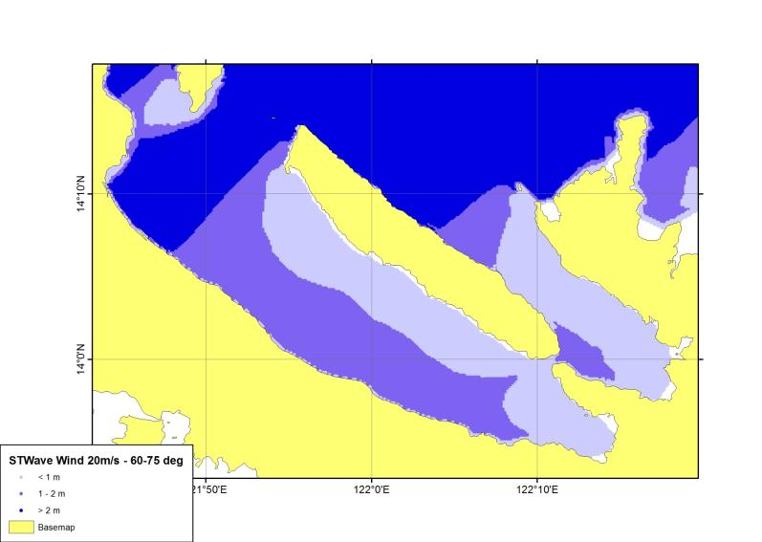
Wave model

Slide 15
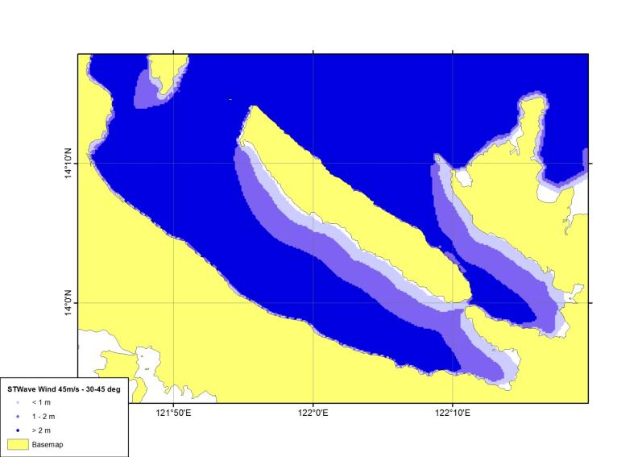
Wave model

Slide 16
Criteria for fishfarming
Suitable depth
  15 to 50 m
Infrastructure
  Road preferable less then 1 km away
Excluding factors
Wave
  More then 1 m height
Rivers
  Large river 3 km, other river 1,5 km
Sensitive areas
  Coral reef 300 m away

Slide 17
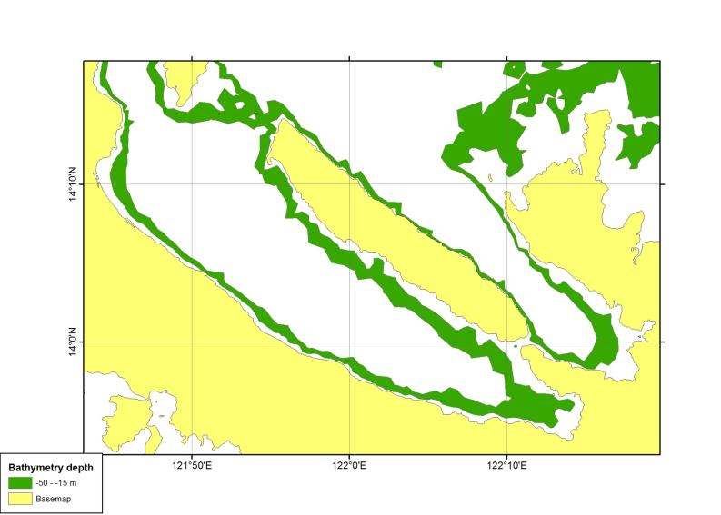
Criteria for mariculture park

Slide 18
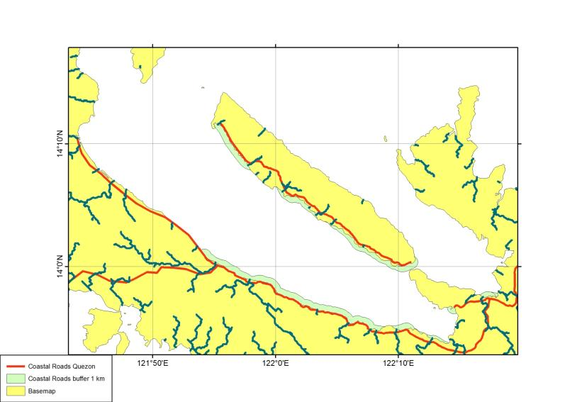
Criteria for mariculture park

Slide 19
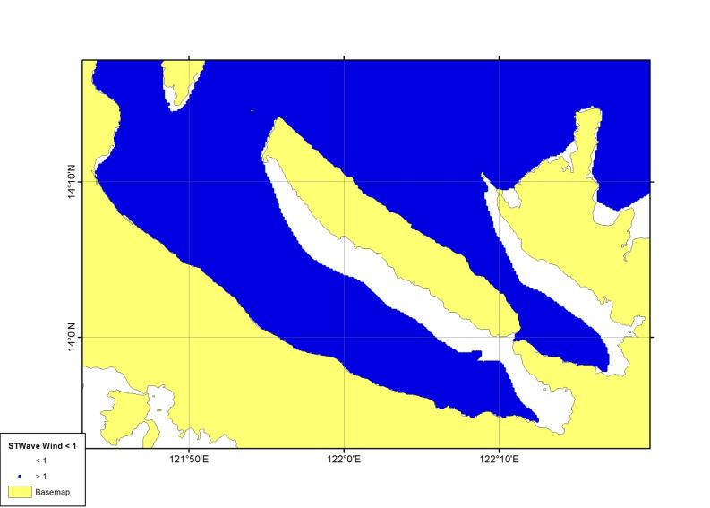
Criteria for mariculture park

Slide 20
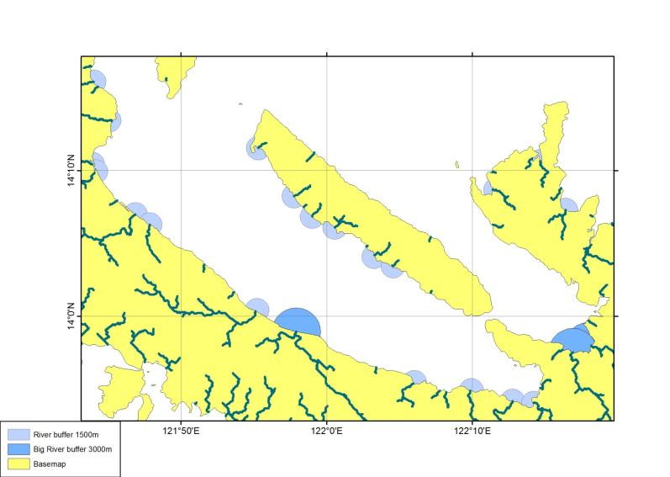
Criteria for mariculture park

Slide 21
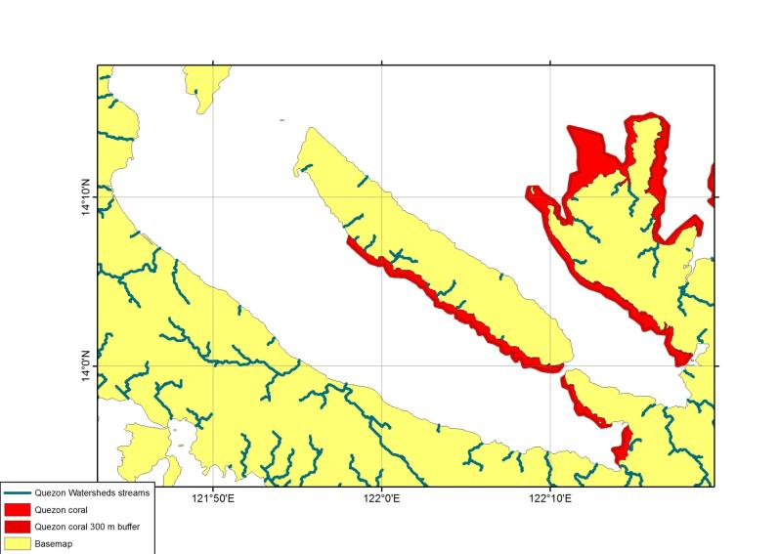
Criteria for mariculture park

Slide 22
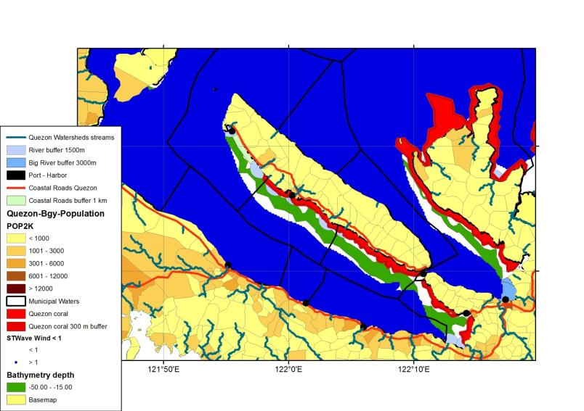
GIS result

Slide 23

GIS result

Slide 24
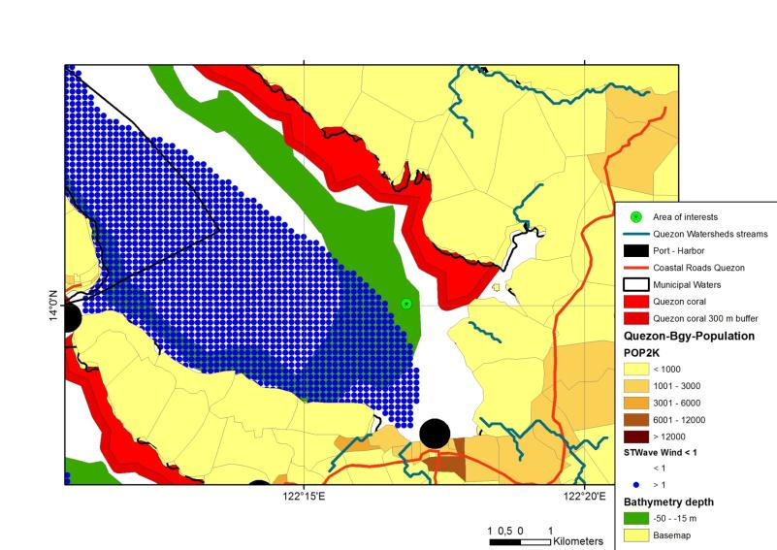
Calauag

Slide 25
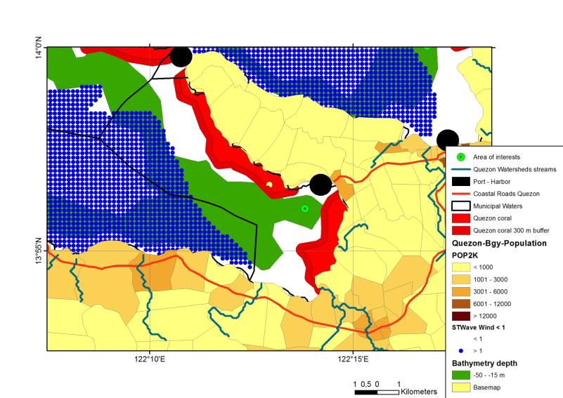
Lopez

Slide 26
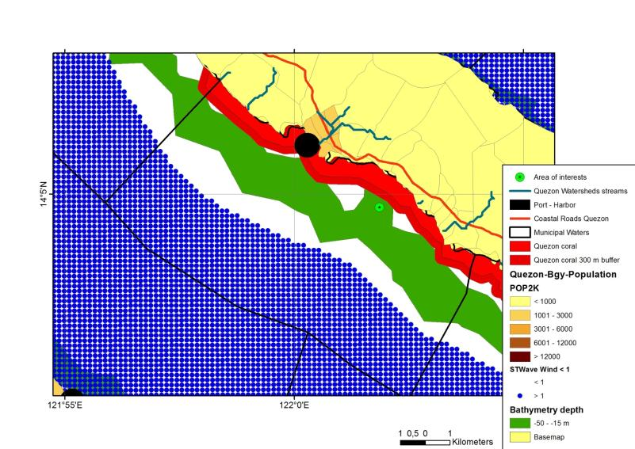
Alabat

Slide 27
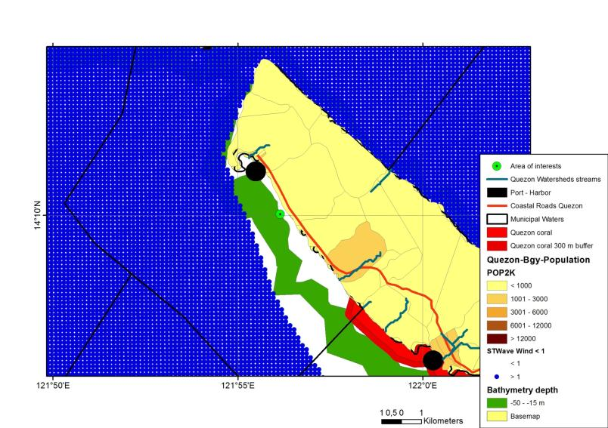
Perez

